Slide 1
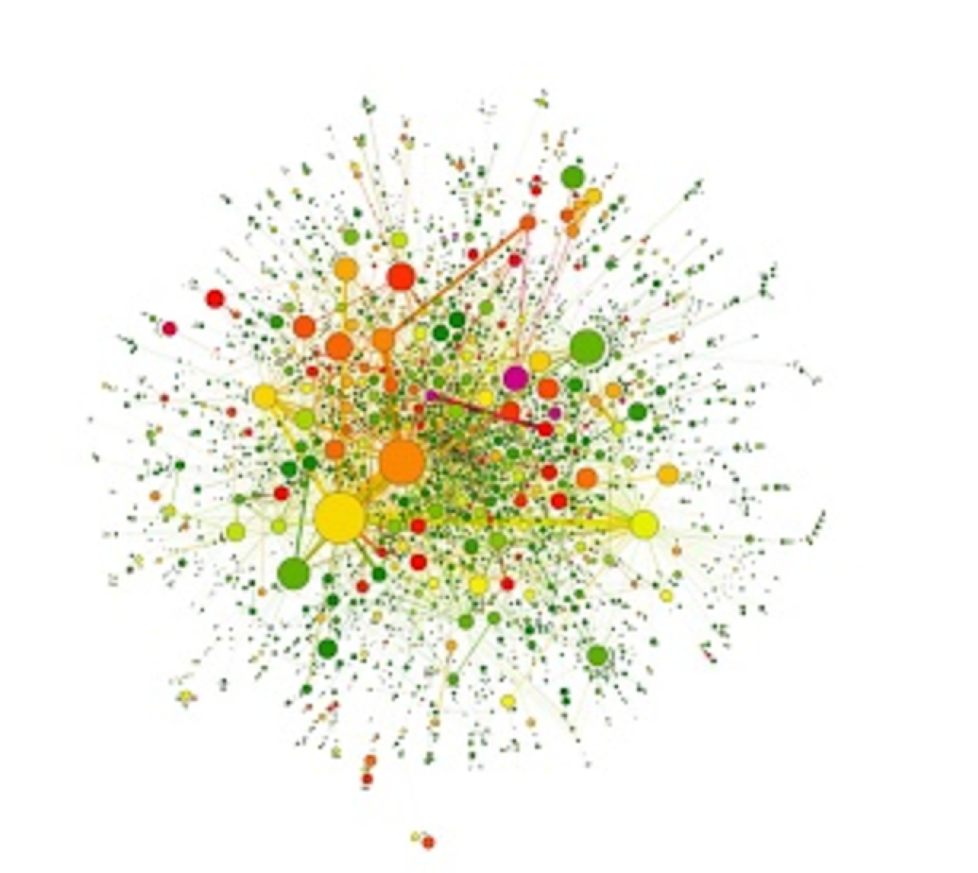
P(egs) bioinformatics for Postgrads
Postgraduate Evolution and Genomic Science Lecture series.

Slide 2

Machine learning and its application on single-cell data
Sumon Ahmed
3rd Year PhD student
Division of Informatics, Imaging and Data Sciences
Faculty of Biology, Medicine and Health
The University of Manchester

Slide 3
Outline
Machine learning and its application on biological data
Data visualization and dimensionality reduction
Application of machine learning on Single-cell data

Slide 4
Machine learning
“it is a field of study that gives the ability to the computer for self-learn without being explicitly programmed” – Arthur Samuel
Learns from the data or experience
Finds pattern from the data
Provides knowledge to machine without hard-coding it

Slide 5
Machine learning vs. Statistics
Statistics
Rely on the assumptions about the data generation systems
Provide explicit inferences by fitting a specified probability model
Usually need enough data from well designed study

Slide 6
Machine learning vs. Statistics
Machine learning
Can use existing data and does not rely on assumption about data generation systems
Concerns about developing models that can improve with experience
Can provide reasonable predictions with the absence of enough data

Slide 7
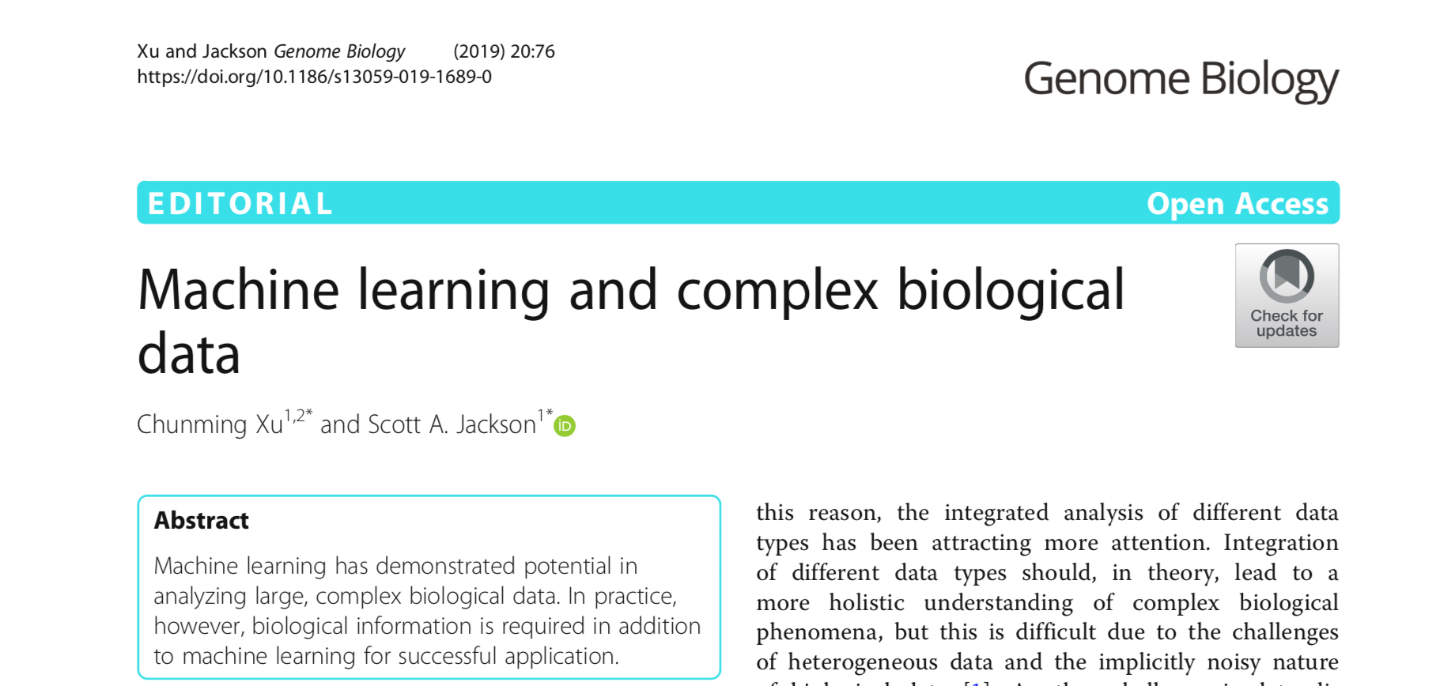
Machine Learning in biology
Biological data are getting bigger and are generated from complex studies
Before data generation was the bottleneck, but now how to extract meaningful information

Slide 8
Data visualization
Gene A | Gene B | Gene C
23 | 34 | 23
12 | 32 | 47
23 | 28 | 35
14 | 28 | 42
24 | 41 | 53
13 | 25 | 51
42
Gene C expression
Gene B expression
14
28
Gene A expression
But usually the number of genes of interest is
many more than three

Slide 9
Data can be represented as vectors
X
42
X₂
X = [X₁, X₂, X₃]
X = [14,28,42]
X₃
14
28
X₁
X₁ is value of feature 1, X₂ is value of feature 2 etc.

Slide 10
High-dimensional data
How can we best visualize data about more than 3 genes? What about D=10,000 genes?
Dimensionality reduction
X = [X₁, X₂, X₃, X₄, …… ,X_{D}]
We call this high-dimensional data where D is the dimension of the data
Often referred to as a data vector or data point

Slide 11
Datasets as a matrix
Usually we have several (N) data points
Then we have a N x D matrix of data
Rows are data points/vectors (e.g. cells, samples)
Columns are features (e.g. expression of gene A)

Slide 12
Dimensionality reduction
A common approach is to use Principal Component Analysis (PCA)
Alternative non-linear methods are also popular, e.g. tSNE, UMAP and GPLVM have all been applied to biological datasets

Slide 13
Principal Component Analysis (PCA)
Most popular dimensionality reduction method for vector data
Make a linear projection of the data into a lower dimension
Choose the projection to retain as much variance in the data as possible
It works on the Covariance Matrix of the data, which captures feature correlations

Slide 14
Data mean and covariance
D-dimensional mean vector has elements
D x D covariance matrix has elements

Slide 15
The covariance matrix
= variance of gene 2
= correlation between genes 1 and 2

Slide 16
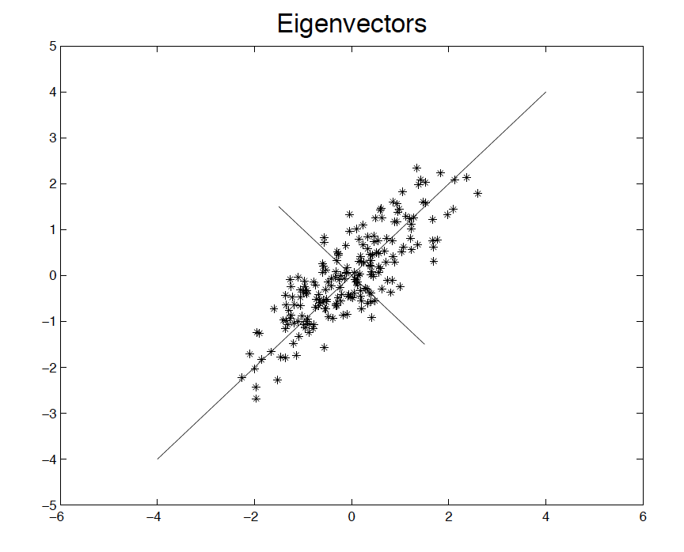

Slide 17
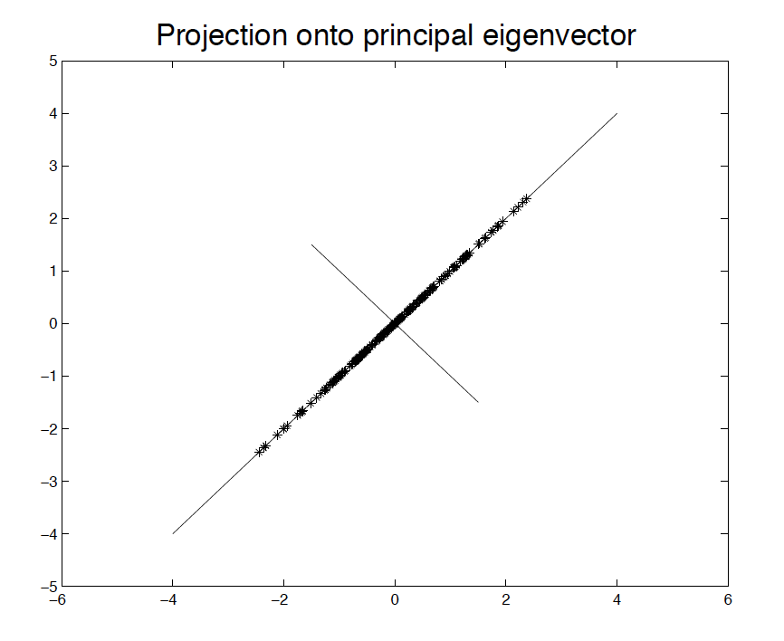
Projection

Slide 18
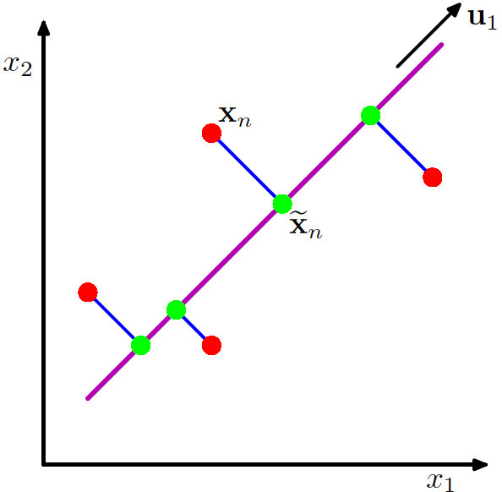
Projecting data onto lower dimension
Pattern Recognition and Machine Learning, Chris Bishop

Slide 19
PCA Coding
sklearn.decomposition.PCA

Slide 20
Single-cell data

Slide 21
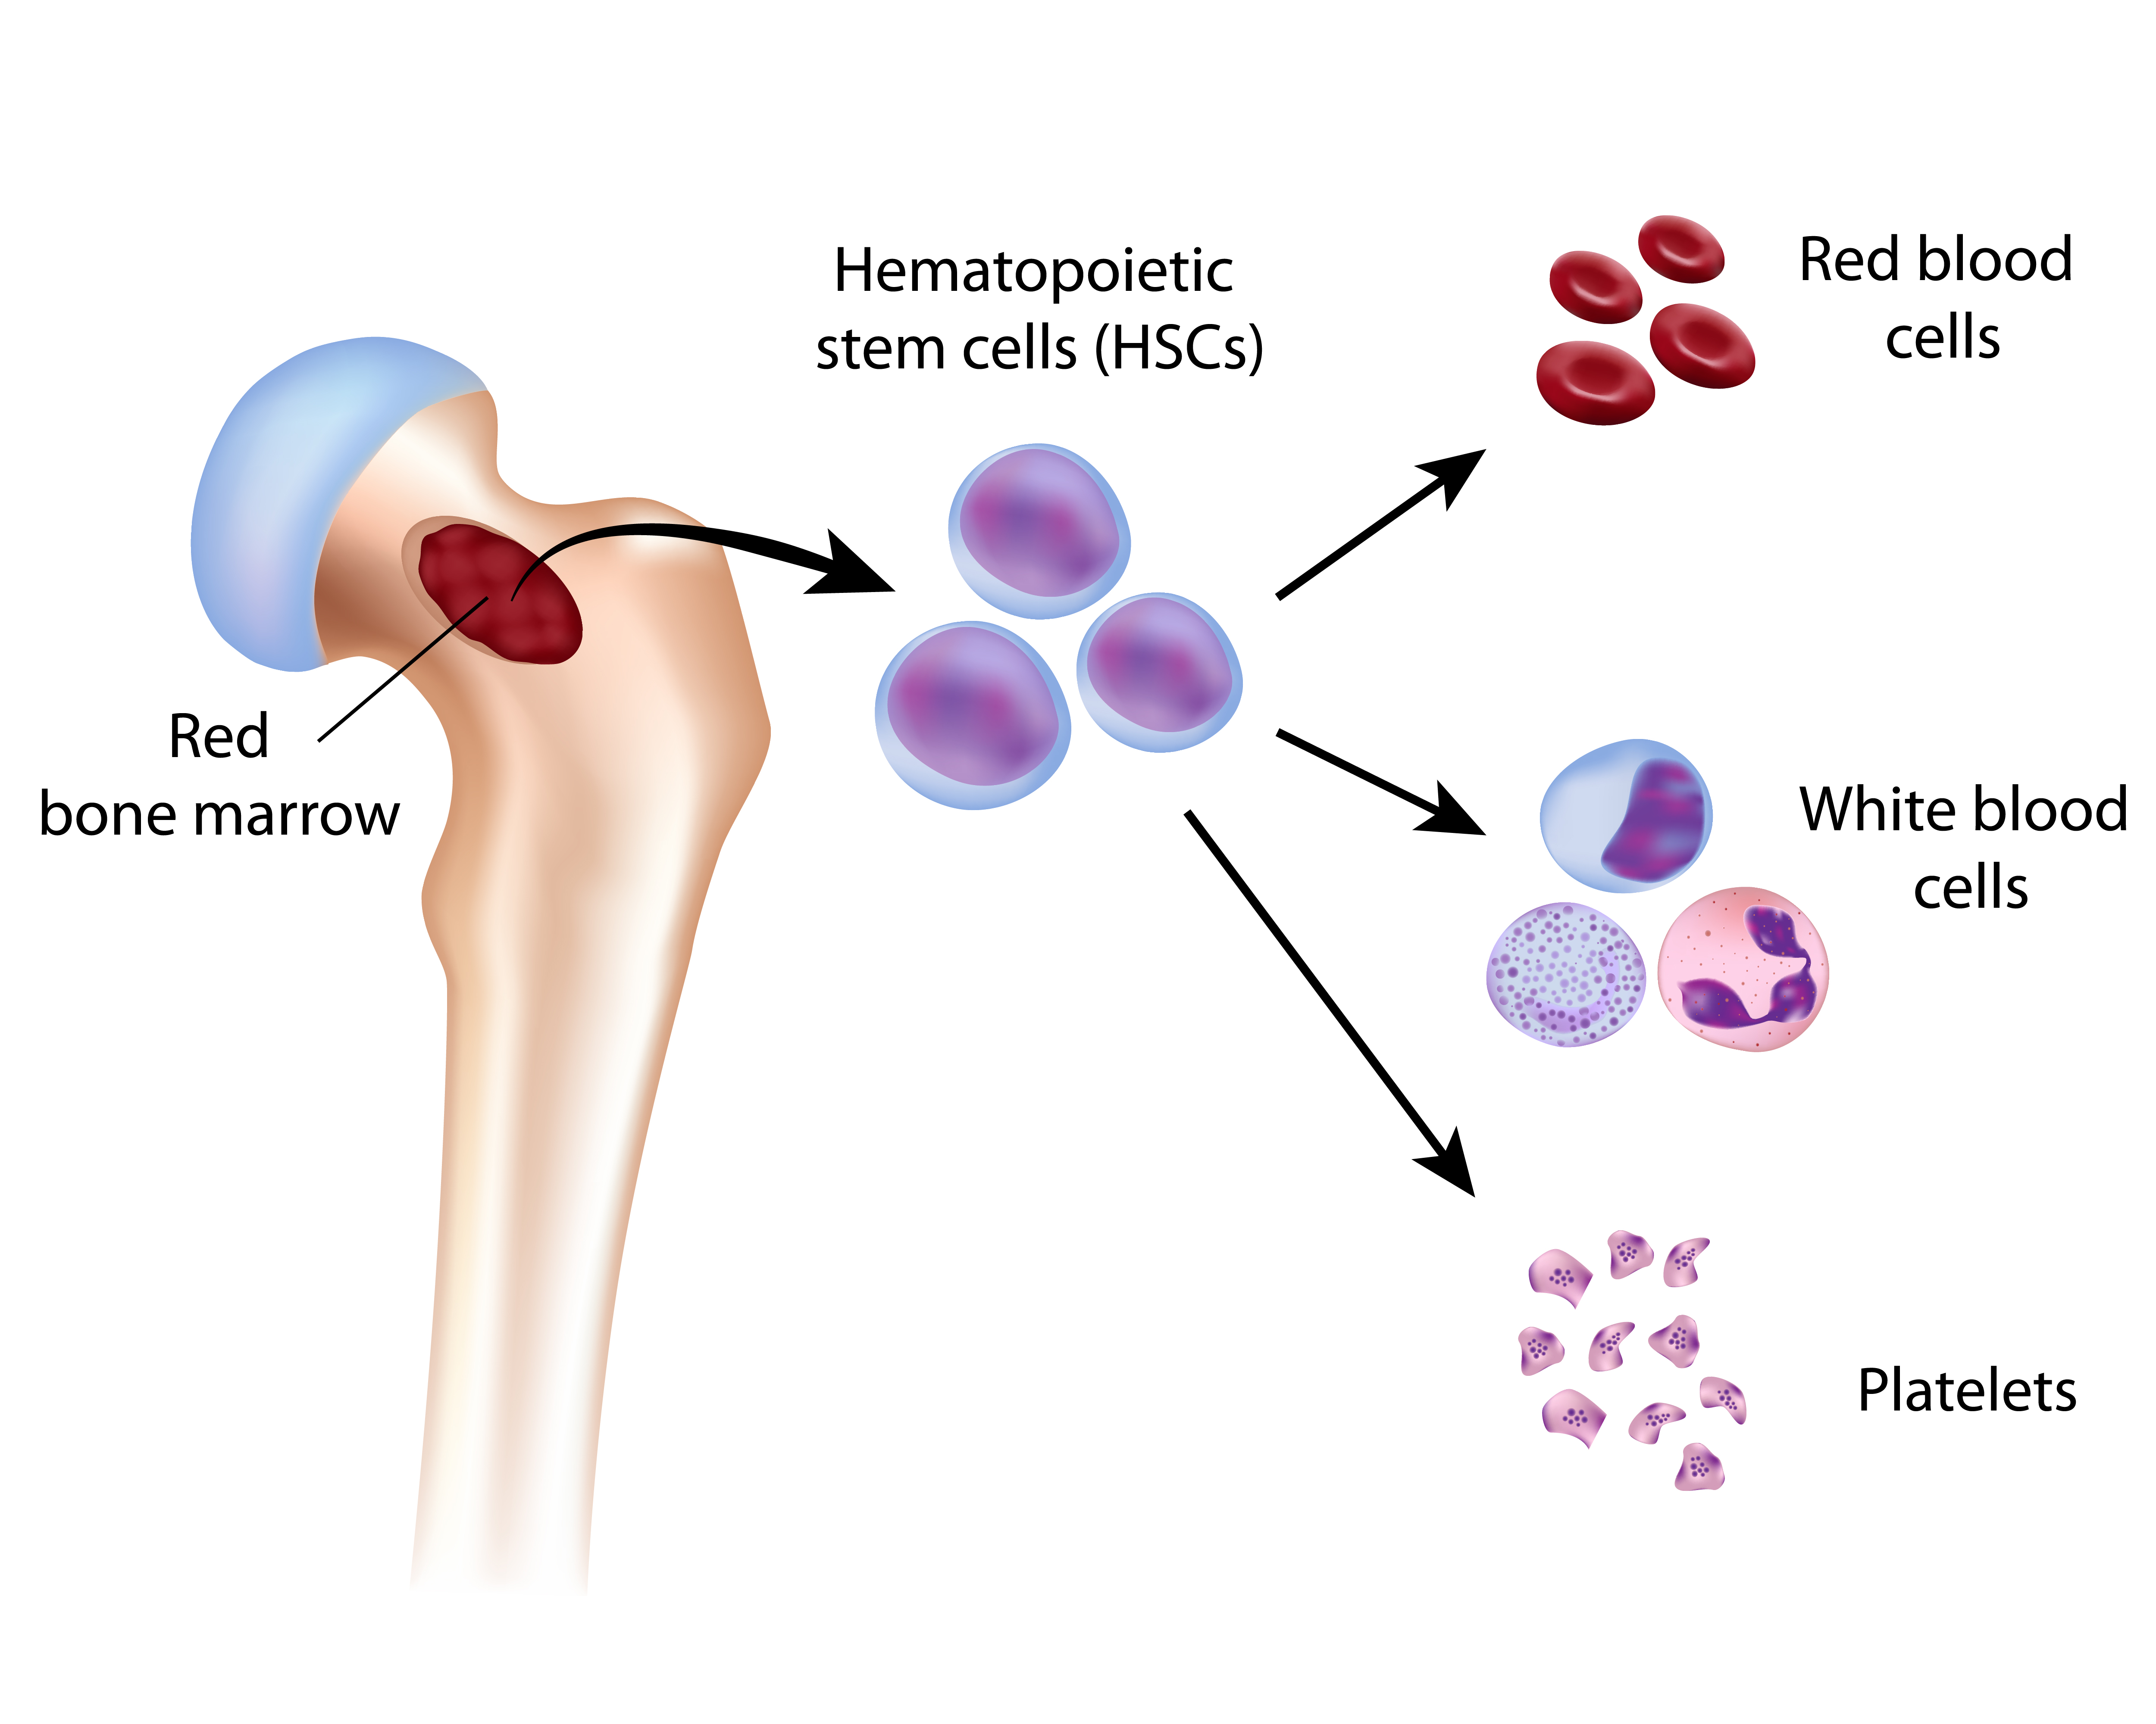
Blood cells generation
The entire blood system can be restored from a single haematopoietic stem cell (HSC)
https://stemexpressdonors.com/adult-stem-cells/

Slide 22
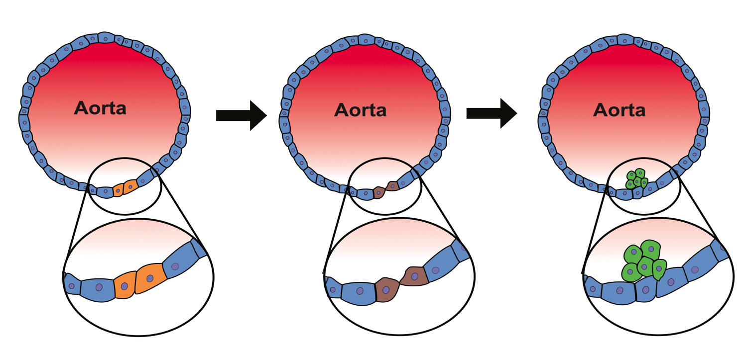
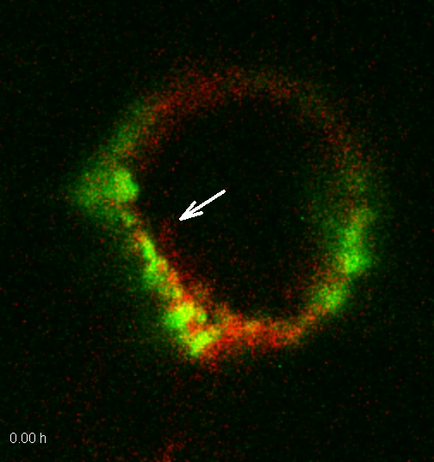
Generation of HSC
Hemogenic endothelium (HE)
Intra-aortic haematopoietic clusters (IAHC)
Endothelium
Undergoing EHT

Slide 23
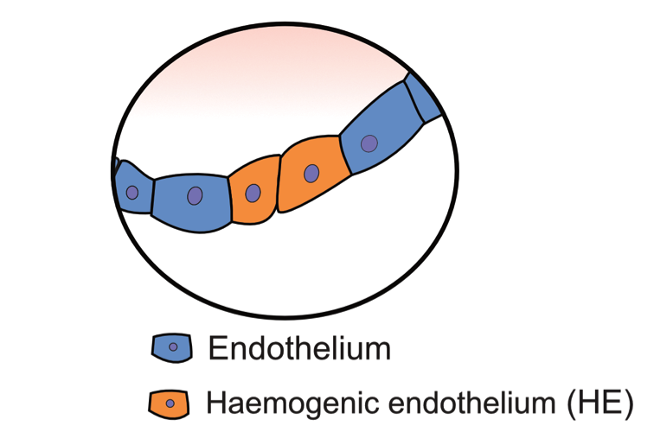
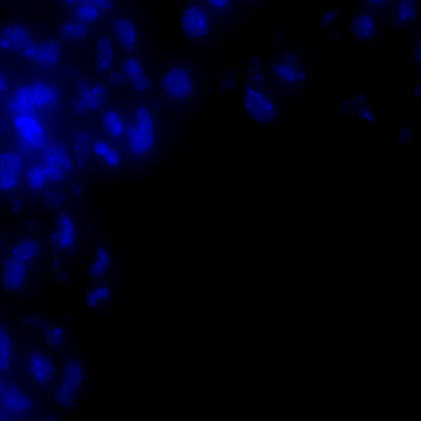

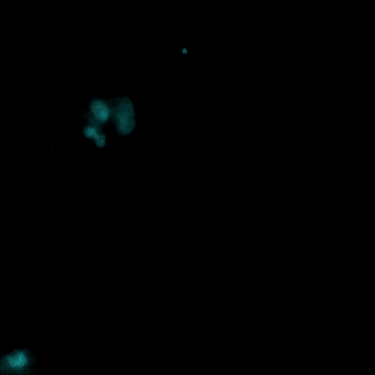
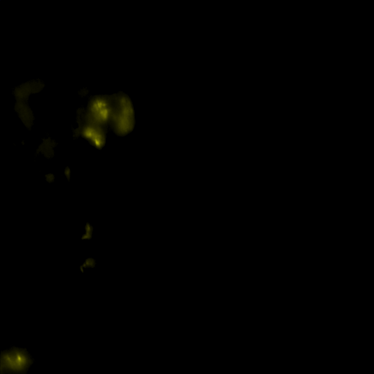
Difference between Endo & HE
Gfi1
Gene A
dapi
cd31
gfi1
Gene A

Slide 24
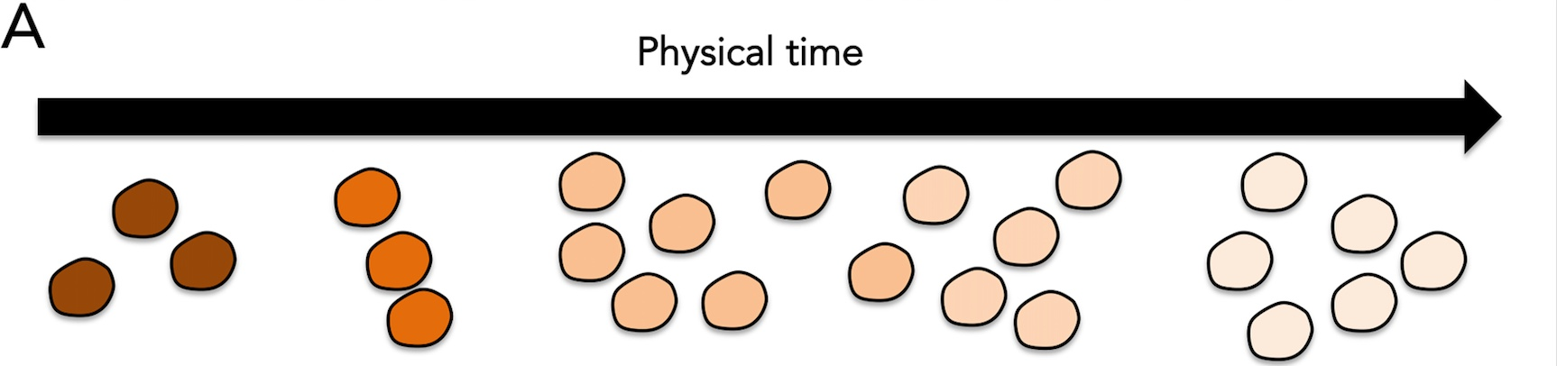
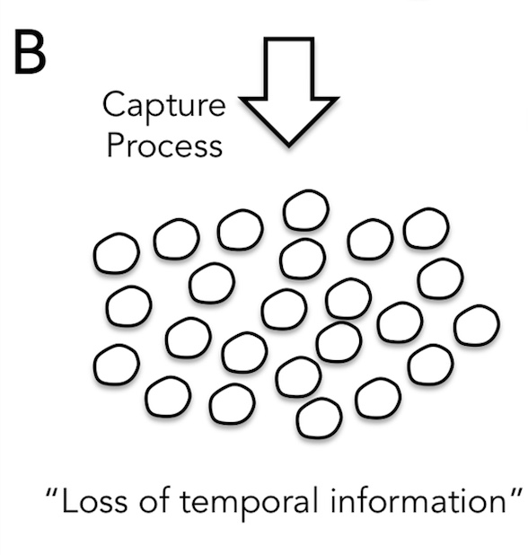
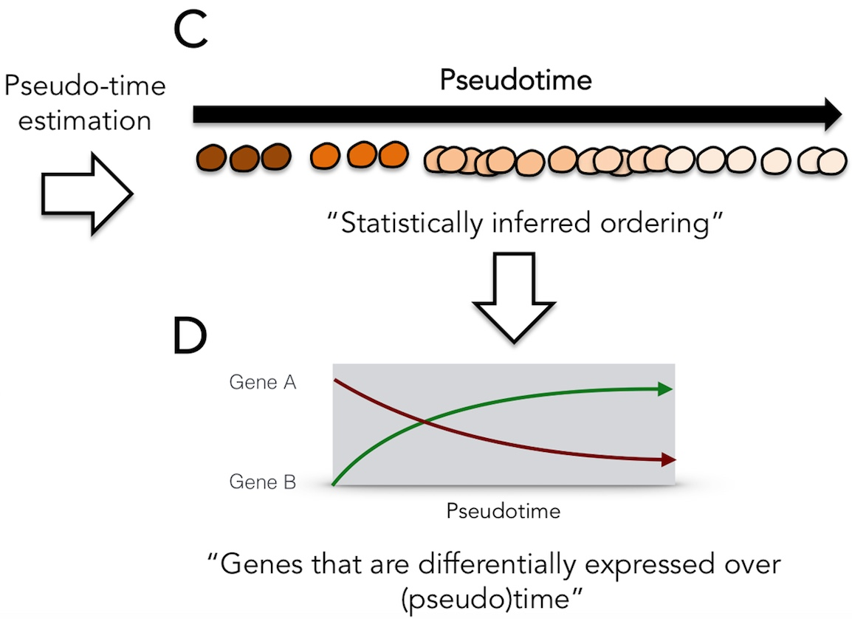
Pseudotime Ordering
Campbell & Yau. PLoS Comput. Biol (2016)

Slide 25
Challenges with Pseudotime ordering
Uncertainty: Pseudotime assignment for the same cell can vary significantly (Campbell & Yau, 2016)
Solution: Probabilistic model, e.g. the Gaussian Process Latent Variable Model (GPLVM)
Non-linear Dimension Reduction
Lawrence, Machine Learning Research (2005)

Slide 26
Gaussian Process (GP)
Probability distributions over functions
f(x) ~ GP (mean(x), cov(x, x*))
Covariance function k = cov(x, x*) defines typical properties
Static...Dynamic
Smooth...Rough
Stationary...non-Stationary
Periodic...Chaotic
The covariance function has parameters tuning these properties
Rasmussen & Williams, Gaussian Processes for Machine Learning, (MIT Press, 2006)

Slide 27
GP Regression
f(x)
x

Slide 28
GP Regression
f(x)
f(x)
x
x

Slide 29
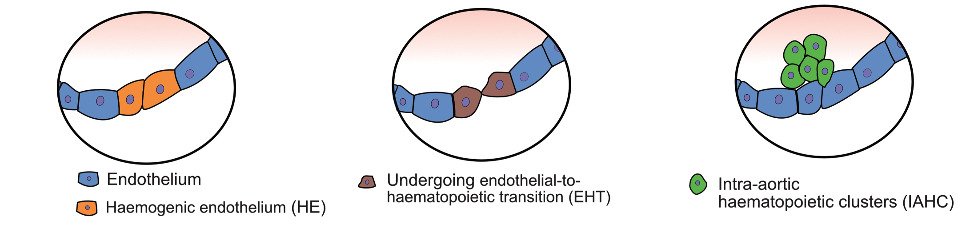
Pseudotime ordering with GPLVM
Embryo stage 10.5 – 160 cells
t0
t1
t2
t3

Slide 30
Pseudotime branching
Single-cell qPCR of early development
437 cells and 48 genes
Three cell states in the 64 cell stage: TE, EPI, PE
PCA
Bayesian GPLVM
PC-2
BGPLVM-2
PC-1
BGPLVM-1 (Pseudotime)
Guo et al. Developmental cell (2014)
Ahmed et al. Bioinformatics(2019)
Notes:
: trophectoderm (TE), epiblast (EPI), and primitive endoderm (PE).
Capture time helps disambiguate pseudotime from branching

Slide 31
Identifying Cell cycle Peak times
Single-cell PC3 human prostate cancer cell line data
Cell cycle nCounter data of 361 cells and 56 genes
McDavid et al. PLoS Comput. Biol (2014)
Ahmed et al. Bioinformatics (2019)

Slide 32
Identifying Precocious Cells
Single cell-RNA seq of mouse dendritic cells
307 cells and 74 genes
Contains two Precocious cells (have pre-expressed genes)
Shalek et al. Nature (2014)

Slide 33
GPLVM Code
Python package and Examples
https://github.com/ManchesterBioinference/GrandPrix

Slide 34
Conclusion
The explosion of data, challenges the existing methods of data analysis
Machine learning is becoming an integrated part of analyzing complex biological data
The ‘curse of dimensionality’ especially in case of sc-data leads to data sparsity, overfitting, etc.
- Dimensionality reduction techniques help

Slide 35

Weka

Slide 36
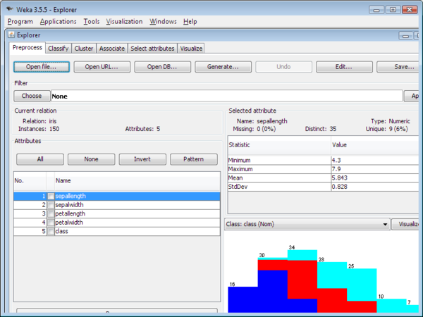
Weka

Slide 37
Thank You!
We would like to say a big thank you to the Division of Evolution and Genomic Science for supporting this series, and all of you for attending!
Please join us for drinks and chat in the café!

Slide 38
Glossaries

Slide 39
Eigenvectors and eigenvalues
Eigenvectors of the covariance matrix are the directions of maximum variance in the data
Eigenvalues give the variance of data associated with each eigenvector
Principal components (W columns) are the first d eigenvectors ranked by largest eigenvalue

Slide 40
Reduced dimension projection
PCA “projects” data onto d < D eigenvectors to get a low dimensional representation
Largest eigenvectors are called Principal Components (PCs – also known as Factors)
Low-d representation are called the Scores or PCA Projection

Slide 41
Inferring Withheld Capture Time
Whole leaf Arabidopsis thaliana microarray data
24 time points and 100 genes
Time series were measured in 2 hours intervals
Actual capture time is withheld in the inference
Windram et al. The Plant Cell (2012)

Slide 42
Regenerating Diffusion Pseudotime(DPT)
Droplet based single-cell RNA-seq of mouse ESCs
2717 cells and 2047 genes. Cell cycle normalized
Convergence Time: ~11s (32 bits float)
~32s (64 bits float)
Haghverdi et al. Nature Methods (2016)
Klein et al. Cell (2015)

Slide 43
Gaussian Processes…
Regression

Slide 44
PCA code – Eigenvectors
Wt, scores, fracs = visualisation.do_pca(IrisData)
Wt is the eigenvector matrix W transposed, so eigenvectors are in the rows of the Wt matrix
Top eigenvectors (with largest eigenvalues) are called the principal components (PCs).
Entries in W are called Factor Loadings – they tell us how much each feature contributes to each PC.

Slide 45
PCA code - Scores
Wt, scores, fracs = visualisation.do_pca(IrisData)
Scores provide low-dimensional projection of the data
Can be plotted to visualise the data in 2D or 3D

Slide 46
PCA code - Eigenvalues
Wt, scores, fracs = visualisation.do_pca(IrisData)
fracs is a vector containing the eigenvalues normalised to sum to one
Ordered from largest to smallest
This represents the fraction of variance explained by each PC

